Slide 1
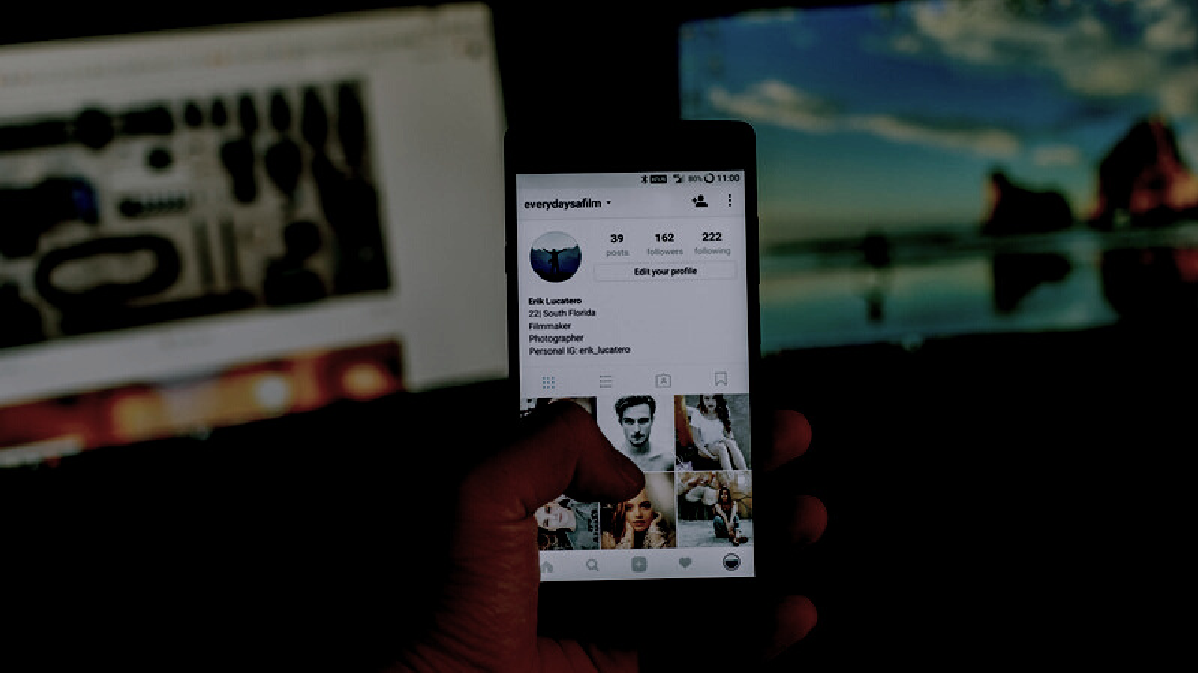
CYBERBULLYING TWEET ANALYSIS
E D I P R O J E C T - P P T F O R E N D S E M E S T E R A S S E S S M E N T - O C T O B E R 2 0 2 2
Div:-AI -B EDI_Group No:- 2 Day:-Friday Date:-16|12|22
Presented by
Project Guide
Prof. Puja Cholke
45 - Samved Patil 48 - Siddhi Patil
- Vaishnavi Petkar
- Mrunmayee Phadke
12110152
12111408
12110717
12110650
Department of Multidisciplinary Engineering
VISHWAKARMA INSTITUE OF TECHNOLOGY, PUNE

Slide 2


Contents
1
Introduction
7
System Requirments
2
Literature Survey
8
Demo of Our Project
3
Problem Statment
9
Advantages and challenges
4
Objectives
10
Conclusion and Future Scope
5
System Architecture
12
References

Slide 3

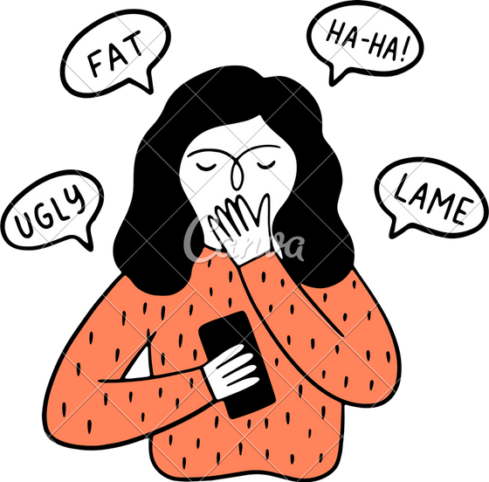
Introduction
People spend more time on social media, that keeps them constantly connected to other people, giving room for cyberbullying and creating the need of cybersecurity.
85% of Indian children are cyberbullied making it global highest.
Cyberstalking, impersonation, and harassment are types of cyberbullying.
Cyberbullies can communicate with their victims through text messaging, social networking websites, and instant messaging over the Internet.

Slide 4
Literature Survey
Title of Paper | Authors | Methodology | Demerits | Publication Year
AI‑Enabled Cyberbullying‑Fre e Online Social Networks in Smart Cities Cyber Bullying Detection using NLP and Text Analytics | Abdulsamad Al‑Marghilani Yeo Khang Hsien, Zailan Arabee Abdul Salam, Vinothini Kasinathan | AI-enabled cyberbullying- free OSN (AICBF- ONS) technique in smart cities. NLP and python based application removes inappropriate tweet and informs guardian about the case via email. | Performance of the AICBF-ONS technique could be extended to the design of outlier detection and data clustering approaches in big data environment Domain-specific, ambiguity | 2022 2022

Slide 5
Literatu Title of Paper | re Surv Authors | ey Methodology | Demerits | Publication Year
An NLP-Assisted Bayesian Time Series Analysis for Prevalence of Twitter cyberbullying during COVID-19 pandemic | Christopher Perez,Sayar Karmarkar | A Pre-trained NLP Model for Pre-processing Data, Sub setting Truly Offensive or Hateful Tweets, Visual Analysis on the Raw and Filtered Counts | It's necessary to develop a model with a new set of data without using a pre- trained model, It can take weeks to achieve a good performance depending on the amount of data. | 2022
Analysing Cyberbullying using Natural Language Processing by Understanding Jargon in Social Media | Bhumika Bhatia, Anuj Verma, Anjum, Rahul Katarya | This paper explores binary classification on multiple datasets. It uses multiple models suchas Bi-LSTM, GloVe, state-of-the-art models like BERT and unique pre-processing technique | This model detects various types of cyberbullying but does not classify them. | 2021

Slide 6
Literature Title of Paper | Survey Authors | Methodology | Demerits | Publication Year
Crime Detection and Analysis from Social Media Messages Using Machine Learning and Natural Language Processing Technique | Xolani Lombo, Oyelade Olaide, Absalom El- Shamir Ezugwu | The system can detect various crimes using Natural language processing algorithms, SVM and classifiers to classify texts. | The accuracy of the models could be increased. | 2022
Analysis of fake news comments in social media | Yulia M. Kuznetsova, Maxim Stankevich | The paper trained model on a huge dataset that was non- biased. |  | 2022

Slide 7
Title of Paper | Authors | Methodology | Demerits | Publication Year
Cyberbullying Detection in Social media using Machine Learning Unsupervised Cyber Bullying Detection in Social Networks | Aditya Desai, Shashank Kalaskar, Omkar Kumbhar, Rashmi Dhumal Michele Di Capua, Emanuel Di Nardo | Proposed model based to be considered while detecting cyberbullying and implement bidirectional deep learning model - BERT. Propose solution for automatic detection of bully traces over a social network, using techniques derived from NLP. | Models have not considered all the necessary features that can be used to identify or classify a statement or post as bullying Clustering efficiency of documents containing bully traces, built upon semantic and syntactic features of textual sentences. | 2021 2020

Slide 8
Literature Title of Paper | Survey Authors | Methodology | Demerits |  | Publica tion Year
Cyberbullying detection using fairness constraints. | Oguzhan Gencoglu | A cyberbully detection model where instead of manipulating dataset. They use fairness constraints of multiple rules to make a model that is context- based. This paper provides a pipeline for cyberbully detection that is Extraction of features Contextualizing the features using crowdsourced feedback in a loop Combing features using the fully connected network to identify and build potential useful features. |  | The datasets used are common ones. and the Twitter dataset has the lowest accuracy of 11.33% | 2020
Linking textual and contextual features for intelligent cyberbullying detection in social media | Nabi Rezvani, Amin Beheshti, Alireza Tablordbar |  | . | This model appears to be specifically designed for Twitter and Instagram. They haven't thought about using any other social media sites. | 2020

Slide 9
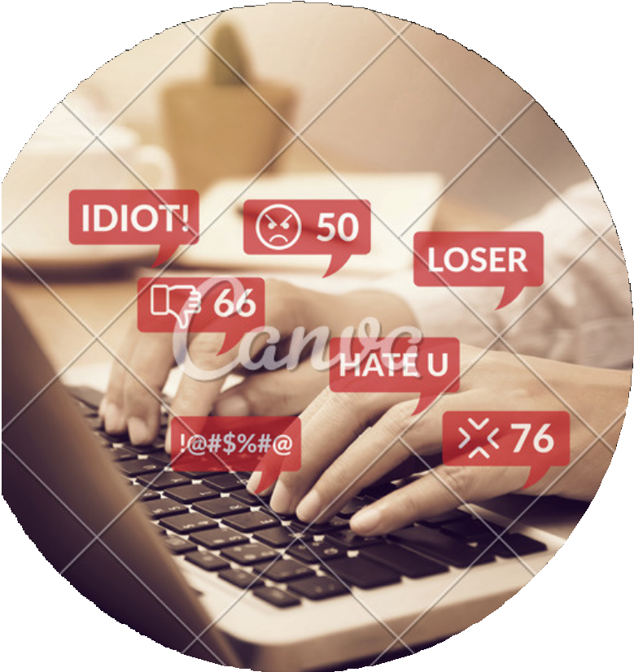



Problem Statement
CYBERSECURITY AND CYBERBULLYING ANALYSIS IN SOCIAL MEDIA TO PREVENT A HOSTILE ENVIRONMENT THAT ERODES ENGAGEMENT AND COLLABORATION OF PEOPLE AND TO MITIGATE THE HEAVY SOCIAL PROBLEM OF CYBER BULLYING.

Slide 10

Objectives
To construct literature survey.
To find unbiased, large and suitable datasets.
To study appropriate data preprocessing techniques.
To research various algorithms for the problem statement.
To detect :
Cyberbullying attack vectors Cybersecure elements

Slide 11


System Architecture
CYBER BULLYING
SENTIMENT ANALYSIS
DATA COLLECTION
DATA PREPROCESSING
CYBER SECURITY
SPAM MESSAGE DETECTION

Slide 12
System Architecture of Cyberbullying
DATA COLLECTION
WORD EMBEDDING
MODEL IMPLIMATATION
DATA CLEANING
DEPLOYEMENT

Slide 13








System Requirements
Tools:
Libraries:
Re

Slide 14
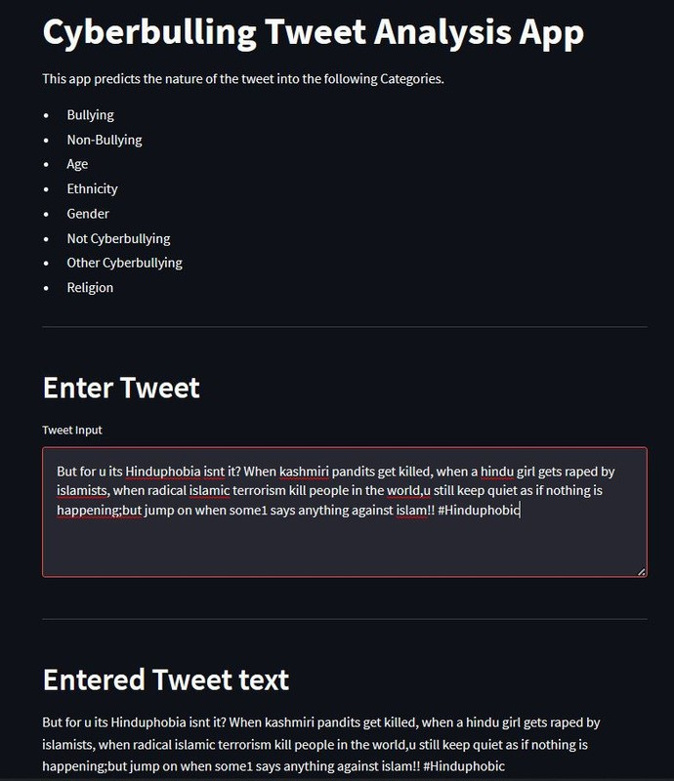
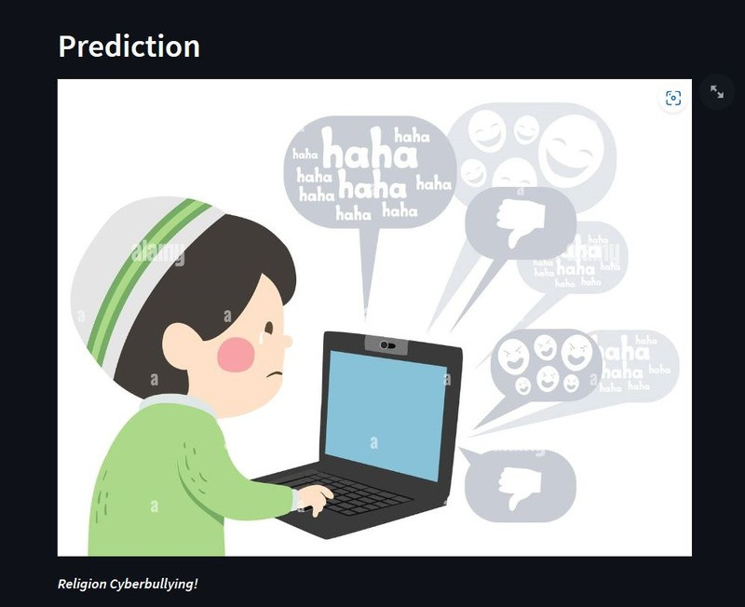
Demo of Our Project

Slide 15
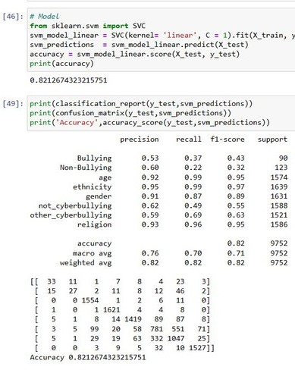
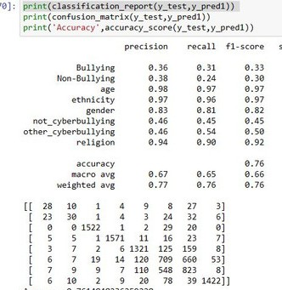
Demo of Our Project

Slide 16
Advantages
Challenges
The access restrictions on high- quality data limit the applicability of state-of-the-art techniques.
Helps identify various forms of cyberbullying and threats to cybersecurity that can be used in different collaborations.
Helps create a safe environment for people of all age, gender and race.
Compiling various types of cyberbullying ways under one general head.

Slide 17

Conclusion
Cybersecurity and tackling cyberbullying is the need of the hour.
Future Scope
COLLABORATION
EXTENSION
AWARENESS AND REPORTS
We can collaborate with various social media platforms like twitter or reddit and integrate our algorithm with theirs. We can also collaborate with the government to reduce cyber crime and harrasement.
We can create a chrome extension. Using web scrapping we can collect the data on user's screen and implement our model on it to alert the user.
We can collect reports and statistics around the current scenario of cybersecurity and cyberbullying in social media. We can create awareness and take measures in required areas based on these statistics.

Slide 18
References
Oguzhan Gencoglu, Cyberbullying Detection with Fairness Constraints, IEEE Xplore,2020 Nabi Rezvani, Amin Beheshti, Alireza Tablordbar, Linking textual and contextual features for intelligent cyberbullying detection in social media, Association for Computing Machinery New York, NY, United States,2021 [1]
Aditya Desai, Shashank Kalaskar, Omkar Kumbhar, Rashmi Dhumal, Cyberbullying Detection in Social media using Machine Learning, ITM web of conferences,2021 [2]
Michele Di Capua, Emanuel Di Nardo, Unsupervised Cyber Bullying Detection in Social Networks, 2016 23rd International Conference on Pattern Recognition (ICPR),2020[3]
Yeo Khang Hsien, Zailan Arabee Abdul Salam, Vinothini Kasinathan, Cyber Bullying Detection using NLP and Text Analytics, IEEE International Conference on Distributed Computing and Electrical Circuits and Electronics (ICDCECE),2022[4]
Christopher Perez, Sayar Karmarkar, An NLP-Assisted Bayesian Time Series Analysis for Prevalence of Twitter cyberbullying during COVID-19 pandemic,Cornell university,2022[5]
Yulia M. Kuznetsova, Maxim Stankevich, Analysis of fake news comments in social media,Journal of Retailing and Consumer Services ,Volume 57, November 2020[6]

Slide 19

Thank You!
We are open to questions.

